Slide 1
Database Management Systems
Lesson 2 – Database Systems Concepts and Architecture
B.R.Madhurangi

Slide 2
Content
Data Models and Data Model Operations
Categories of Data Models
Implementation Data Models
Schemas Vs. Instances
Database Schema Vs. Database State
Three-Schema Architecture
Some more about DBMSs

Slide 3
Data Models
Data Model
A set of concepts to describe the structure of a database, and certain constraints that the database should obey
i.e.: data types, relationships
Data Model Operations
Operations for specifying database retrievals and updates by referring to the concepts of the data model
Operations on the data model may include basic operations (insert, delete, modify, retrieve) and user-defined operations (i.e.: calculate GPA of a student)

Slide 4
Categories of Data Models
Conceptual (high-level) data models:
Provide concepts that are close to the way many users perceive data. (Also called entity-based or object-based data models.)
Physical (low-level, internal) data models:
Provide concepts that describe details of how data is stored in the computer (mainly for computer specialists, not for end users)
Implementation (representational) data models:
Provide concepts that fall between the above two, balancing user views with some computer storage details.

Slide 5
Implementation (representational) Data Models
Relational Model:
proposed in 1970 by E.F. Codd (IBM), first commercial system in 1981-82
Network Model:
The first one to implement was Honeywell in 1964-65 (IDS System)
Hierarchical Data Model:
Implemented in a joint effort by IBM and North American Rockwell around 1965
(Relational data models are widely used,
network models and hierarchical models are
called legacy data models .They have been widely used in the past)

Slide 6
“Relations”
Can be represented as tables in which rows represent “tuples” and columns represents attributes
A relation may be described by its name and the related attributes
Eg (Employee (Emp_no, Emp_ name, Age, Start_date, Address……. )

Slide 7
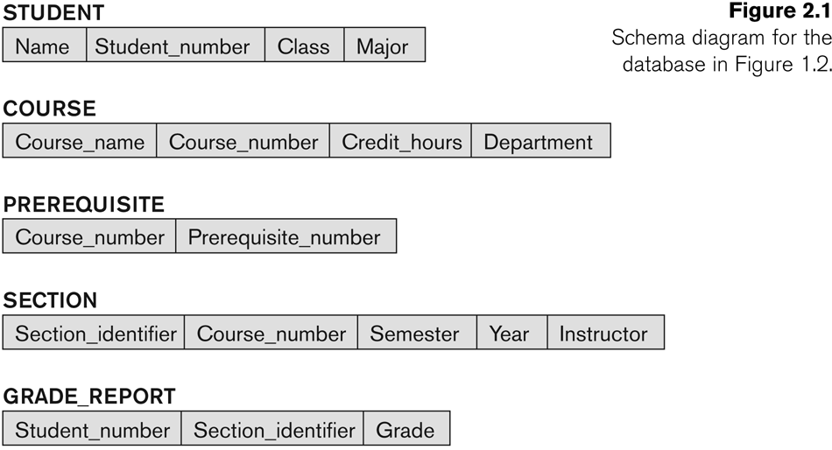
Relational Database - Example
Exists
Has
Has
Has

Slide 8
Features of Relational DBMS
2-D tables (rows and columns representing records/tuples and fields/attributes)
Dynamic links among tables
Easy and flexible to design and use
Data independence
Generic manipulation language (SQL)

Slide 9
Hierarchical Model
Represents a hierarchy with the whole at the root and the components forms the child nodes in turn
Thus, all the components or the nodes, taken together form the whole

Slide 10
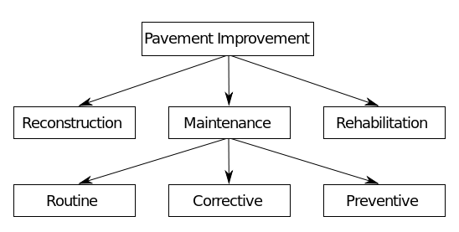
Hierarchical Model

Slide 11
Hierarchical Model
Advantages:
Hierarchical Model is simple to construct and operate
Corresponds to a number of natural hierarchically organized domains -e.g., assemblies in manufacturing, personnel organization in companies
Language is simple; uses constructs like GET, GET UNIQUE, GET NEXT, GET NEXT WITHIN PARENT etc.
Disadvantages:
Navigational and procedural nature of processing
Database is visualized as a linear arrangement of records
Little scope for "query optimization"

Slide 12
Network Model
Resembles the hierarchical model with a provision for a record to have more than one parent
An owner record is equivalent to a parent, and a member record s equivalent to a child in the hierarchical model
The difference is that a record can appear as a member in more than one set

Slide 13
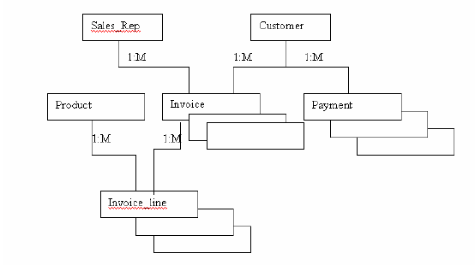
Network Model

Slide 14
Network Model
Advantages :
Able to model complex relationships and represents semantics of add/delete on the relationships
Can handle most situations for modeling using record types and relationship types
Language is navigational
Uses constructs like FIND, FIND member, FIND owner, FIND NEXT within set, GET etc. Programmers can do optimal navigation through the database.
Disadvantages:
Navigational and procedural nature of processing
Database contains a complex array of pointers that thread through a set of records
Little scope for automated "query optimization”

Slide 15
Schemas Vs. Instances
Database Schema: The description of a
database.
Includes descriptions of the database structure
and the constraints that should hold on the
database.
Schema Construct: A component of the
schema or an object within the schema
i.e.: STUDENT, COURSE.
Schema Diagram: A diagrammatic display of
Database Instance: The actual data stored in
(some aspects of) a database schema.
a database at a particular moment in time.
Also called database state (or occurrence).
Whenever a value in the database is updated
the database state is changed

Slide 16
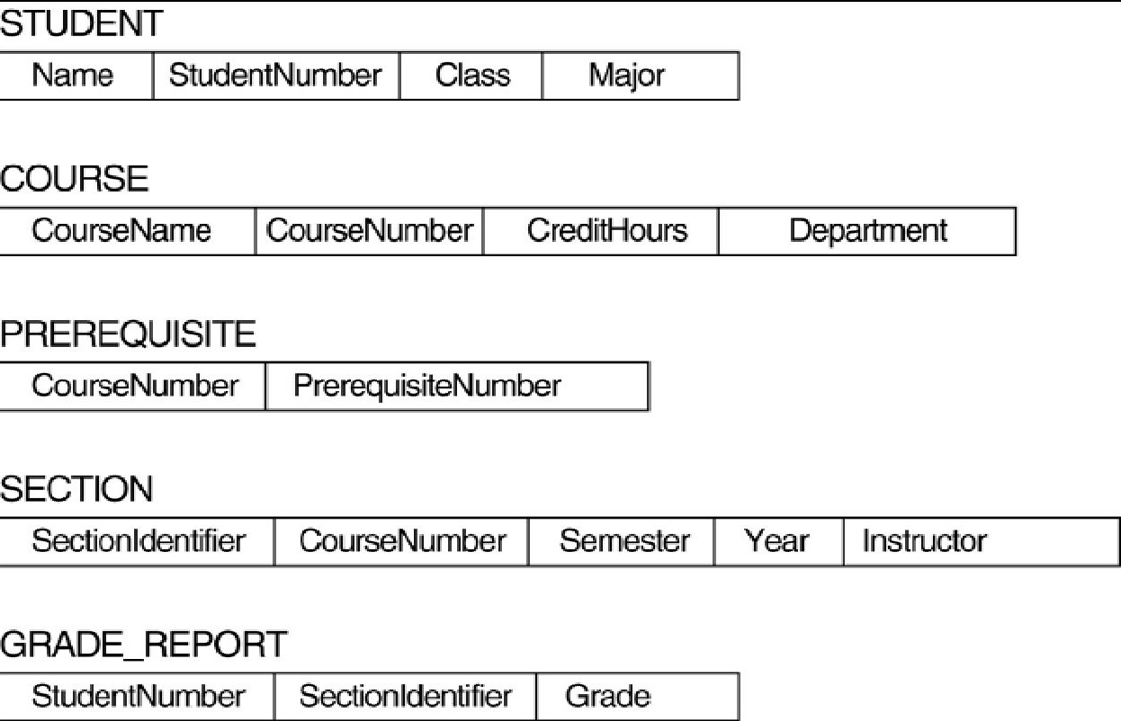
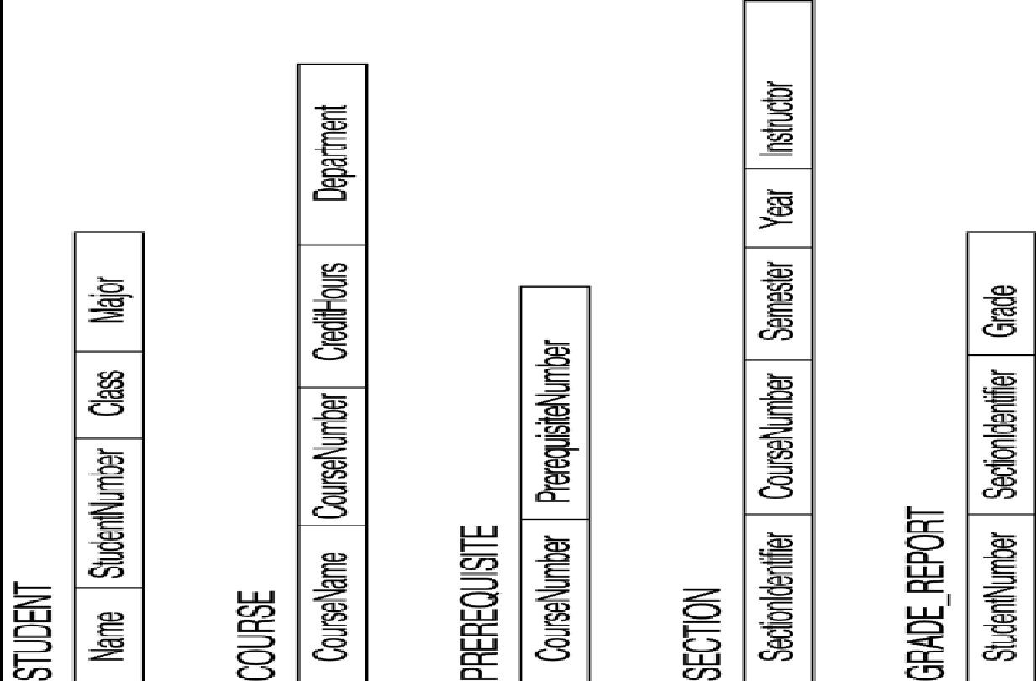
Schema Diagram for a Database

Slide 17
Database Schema Vs. Database State
Database State
Refers to the content of a database at a moment in time
Initial Database State
Refers to the database when it is loaded
Valid State
A state that satisfies the structure and constraints of the database
The database schema changes very infrequently. The database state changes every time the database is updated

Slide 18
Data Organization
Logical organization
conceptual or logical format of the data
(e.g., employee record has E#, Name, Address)
Physical organization
actual structure of the data and all supporting access structures (e.g., index)
(e.g., employee: E# 32 bits, Name 30 bytes, Address 50 bytes)
Benefits
application programs must know the logical organization but the physical organization is an implementation detail they need not know

Slide 19
Three-Schema Architecture
Proposed to support DBMS characteristics of:
Program-data independence ( To separate the user applications and the physical database)
Support of multiple views of the data
Use of schema to store the DB description (mete-data)

Slide 20
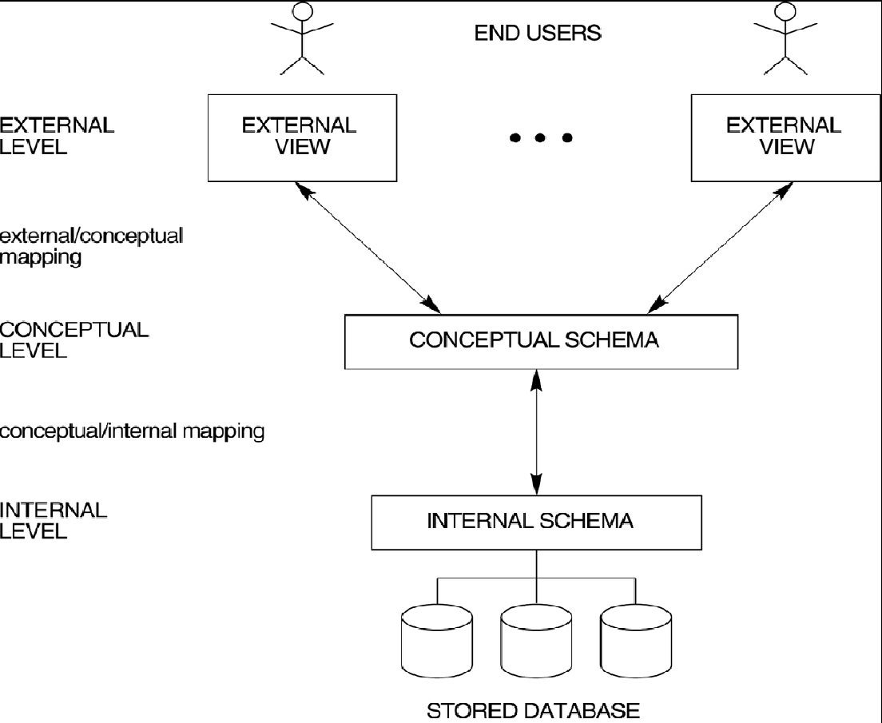
Three-Schema Architecture
contd.

Slide 21
Three-Schema Architecture
contd.
Internal schema
Describe physical storage structures and access paths.
Typically uses a physical data model
Describes the complete details of data storage and access paths for the
database
Conceptual schema
Describe the structure and constraints for the whole database for a
community of users
Hides the details of physical storage structures and concentrate on
describing data types, relationships, user operations, entities and
constraints.
Uses a conceptual or an implementation data model.
External schemas
Describes a subset of the database that a particular user group is interested in, according to the format the format user wants, and hides the rest
Uses the same data model as the conceptual level
may contain virtual data that is derived from the files, but is not explicitly stored.

Slide 22
Three-Schema Architecture
contd.
Mappings among schema levels are needed to transform requests and data between levels.
Programs refer to an external schema, and are mapped by the DBMS to the internal schema for execution.
If the request is a database retrieval, the data extracted from the stored database is reformatted to match the users external view.

Slide 23
Data Independence
The disjointing of data descriptions from the application programs (or user-interfaces) that uses the data
When a schema at a lower level is changed, only the mappings between this schema and
higher-level schemas need to be changed in a DBMS that fully supports data independence. The higher-level schemas themselves are unchanged. Hence, the application programs need not be changed since they refer to the external schemas.

Slide 24
Logical Data Independence
Logical Data Independence: The capacity to change the conceptual schema without having to change the external schemas and their application programs.
ex: Employee (E#, Name, Address, Salary)
A view including only E# and Name is not affected by changes in any other attributes.

Slide 25
Physical Data Independence
Physical Data Independence: The capacity to change the internal schema without having to change the conceptual schema.
The ability to modify the physical scheme without causing application programs to be rewritten
e.g. reorganize some physical files, by creating additional access structures to improve the performance of retrieval or update.
**

Slide 26
DBMS Languages
Data Definition Language(DDL)
Data Manipulation language(DML)
storage definition language (SDL)
Data Control Language(DCL)
view definition language (VDL)
Transaction Control Language(TCL) –this is also another type

Slide 27
DBMS Languages
Data Definition Language (DDL)
Used by the DBA and database designers to specify the conceptual schema of a database
In many DBMSs, the DDL is also used to define internal and external schemas (where strict separation of levels is not maintained ).
In some DBMSs, separate storage definition language (SDL) is used to define internal schemas and view definition language (VDL) is used to define conceptual schemas. (where clear separation of levels is maintained ).
Data Manipulation Language (DML): Used to specify database retrievals and updates. Helps the user to manipulate the database.

Slide 28
Data Definition Language (DDL)
A data definition language or data description language (DDL) is a syntax similar to a computer programming language for defining data structures, especially database schemas.
For DBA and database designers
to specify the conceptual schema
also used to define internal and external schemas (views).
In some DBMSs, separate storage definition language (SDL) and view definition language (VDL) are used to define internal and external schemas.

Slide 29
Data Definition Language (DDL)
Used to create and modify database objects
Create
Drop
Alter
Truncate

Slide 30
Data Manipulation Language (DML):
A data manipulation language (DML) is a family of syntax elements similar to a computer programming language used for inserting, deleting and updating data in a database. Performing read-only queries of data is sometimes also considered a component of DML.
DML commands can be embedded in a general-purpose programming language (host language), such as COBOL, C, Java or an Assembly Language.
Alternatively, stand-alone DML commands can be applied directly (query language).

Slide 31
Data Manipulation Language (DML)
Used to create, modify and retrieve data
Insert
Select
Update
Delete

Slide 32
Data Control Language
A data control language (DCL) is a syntax similar to a computer programming language used to control access to data stored in a database. In particular, it is a component of Structured Query Language (SQL).
Examples of DCL commands include:
GRANT to allow specified users to perform specified tasks.
REVOKE to cancel previously granted or denied permissions.

Slide 33
Transaction Control Language
Transaction Control Language (TCL) - Transaction control commands manage changes made by DML commands. These SQL commands are used for managing changes affecting the data. These commands are COMMIT, ROLLBACK, and SAVEPOINT.

Slide 34
DBMS Interfaces
Interfaces are used by users for interacting with the database
User-friendly interfaces:
Menu-based, popular for browsing on the web
Gives the user a list of options called menus that leads the user through the formulation of a request.
Forms-based, designed for naïve users
Users can fill out the form entries to insert data.
Graphics-based (Point and Click, Drag and Drop etc.)
A user can specify a query by manipulating a diagram.
Natural language: requests in written English
Combinations of the above

Slide 35
Other DBMS Interfaces
Parametric interfaces (i.e.: bank
tellers) using function keys.
A small set of commands is included, with
the goal of minimizing the number of
keystrokes required for each record.
Interfaces for the DBA:
Most database systems contains privileged
commands that can be used only by the
DBA’s staff.
Creating accounts, granting authorizations
Setting system parameters
Changing schemas or access path (
reorganize the storage structure of a
database )

Slide 36
Database System Utilities
Database utilities help the DBA in managing the database system.
Perform certain functions such as:
Loading data stored in files into a database. (Known as data conversion tools.)
Backing up the database periodically on tape.
Restore the database in case of a failure.
Reorganizing database file structures.
Report generation utilities.
Performance monitoring utilities.
Other functions, such as sorting, user monitoring, data compression, etc.

Slide 37
Database Architectures
The database architecture is the set of specifications, rules, and processes that dictate how data is stored in a database and how data is accessed by components of a system.
Centralized DBMS
Combines everything into single system including-DBMS software, hardware, application programs and user interface processing software.
Most user accessing computer terminal did not have processing power and only provided display capabilities.

Slide 38
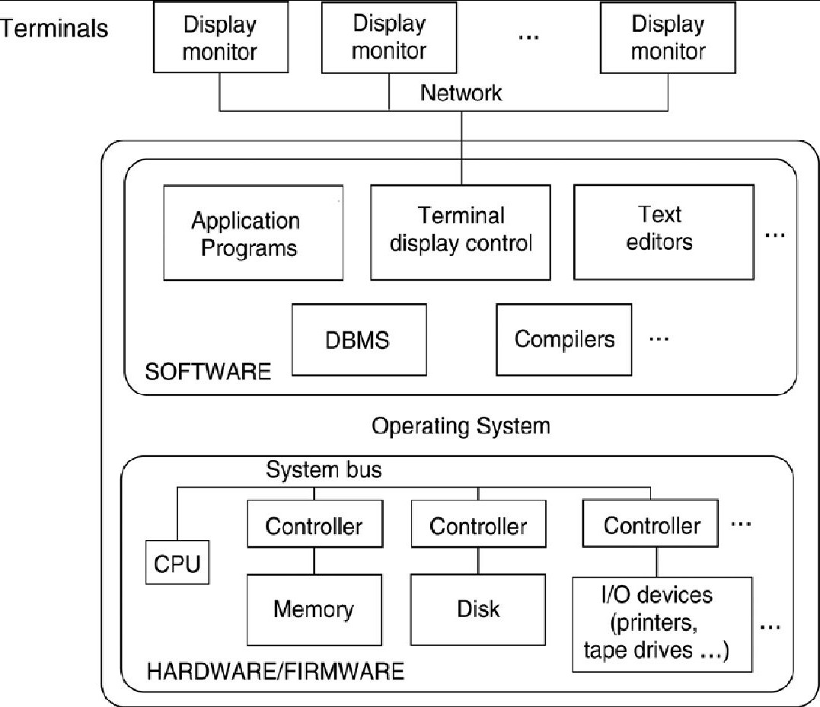
Centralized DBMSs

Slide 39
Database Architectures
contd.
Basic Client-Server Architectures
Consists of
Specialized Servers functions
Clients
DBMS Server
Specialized Servers with special functions
File Servers
Printer Servers
Web Servers
E-mail Servers

Slide 40
Client – Server Architecture
contd.
Clients
Provide appropriate interfaces and a client-version of the system to access and utilize the server resources.
Clients maybe diskless machines or PCs or Workstations with disks with only the client software installed.
Connected to the servers via some form of a network. (LAN: local area network, wireless network, etc.)
DBMS Server (query and transaction servers)
Provides database query and transaction services to the clients
When DBMS access is required, the application programs in the client side establishes a connection to the DBMS.
Then the client program can communicate with the DBMS. (send query and transaction requests). These requests are processed at the sever site and the results are sent back to the client program and this program can process or display results

Slide 41
Database Architecture
Database architecture divided into two types
Logical 2 tier client server architecture
Logical 3 tier client server architecture

Slide 42
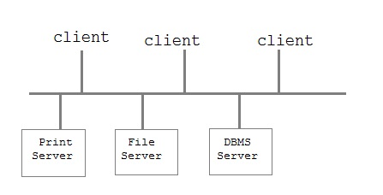
Two tier client server architecture
Is used for user interface programs and application programs that run on client side.

Slide 43
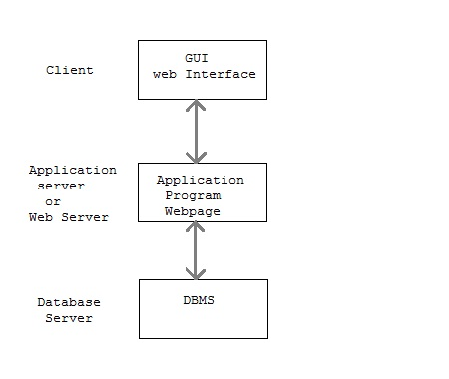
Three tier client server architecture
This is used in web application

Slide 44
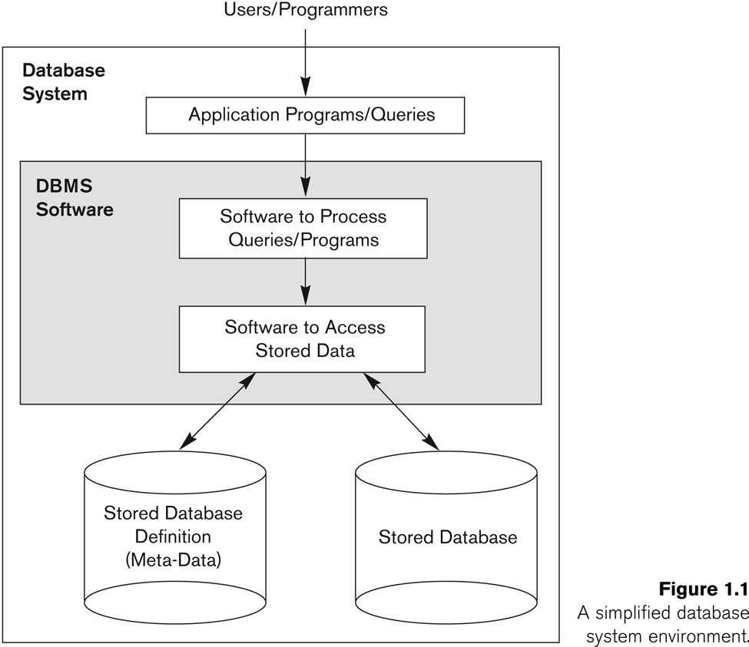
A simplified database system environment

Slide 45
Classification of DBMSs
Based on the data model used:
Traditional: Relational, Network, Hierarchical.
Emerging: Object-oriented, Object-relational.
Based on the number of users supported:
Single-user (typically used with personal computers) vs. multi-user (most DBMSs, support multiple users concurrently).
Based on the number of sites over which the database is distributed:
Centralized (uses a single computer with one database) vs. distributed (uses multiple computers, multiple databases)
Based on the cost of the DBMS

Slide 46
Thank You!

